Slide 1
The NACHC hiv-cds Project and SMART on FHIR
Goals of the NACHC hiv-cds Project
Implementation Strategy for the NACHC hiv-cds Project
SMART on FHIR in the NACHC hiv-cds Project

Slide 2

Most of the Concepts We Will Discuss Are Trademarked
Notes:
Many of the concepts included in this presentation are trademarked including those shown here.

Slide 3
Introduction

Slide 4
Introduction
The NACHC hiv-cds Project and SMART on FHIR
Mission statement and project goals
Implementation strategy for the realization of the mission statement
The hiv-cds Implementation Guide
SMART on FHIR implementation of the hiv-cds Implementation Guide

Slide 5
NACHC hiv-cds Project Mission Statement
The goal of the NACHC hiv-cds project is to reduce HIV infection by improving compliance with CDS guidelines for HIV testing. By increasing testing where it is most needed, we will improve the time to treatment and prevention in at risk patients thereby reducing overall HIV transmission.
The NACHC hiv-cds project will develop a SMART on FHIR clinical decision support application that will identify patients who do not meet CDS hiv-testing guidelines at the point of care and notify clinicians so these tests can be ordered. The NACH hiv-cds project will also provide a SMART on FHIR survey application that will enable clinicians and patients to provide the data required to identify HIV testing requirements.

Slide 6
The CDS Guidelines for HIV testing and the hiv-cds FHIR Implementation Guide

Slide 7
CDS Guidelines for HIV testing and the hiv-cds Implementation Guide (IG)
A FHIR Implementation Guide has been created for the hiv-cds SMART on FHIR application
The hiv-cds FHIR Implementation Guide gives instructions on how to create an application that implements the CDS guidelines for HIV testing. This includes both human readable instructions as well as resources that can be used to automate the creation of these SMART on FHIR applications
The Implementation Guide formalizes the CDS guidelines and provides both human readable and computable resources to enable both custom and automated implementation of these guidelines
The Implementation Guide contains details for the implementation of clinical decision support for HIV testing as well as a survey that captures the information required for the CDS HIV testing guidelines
https://build.fhir.org/ig/cqframework/hiv-cds/

Slide 8
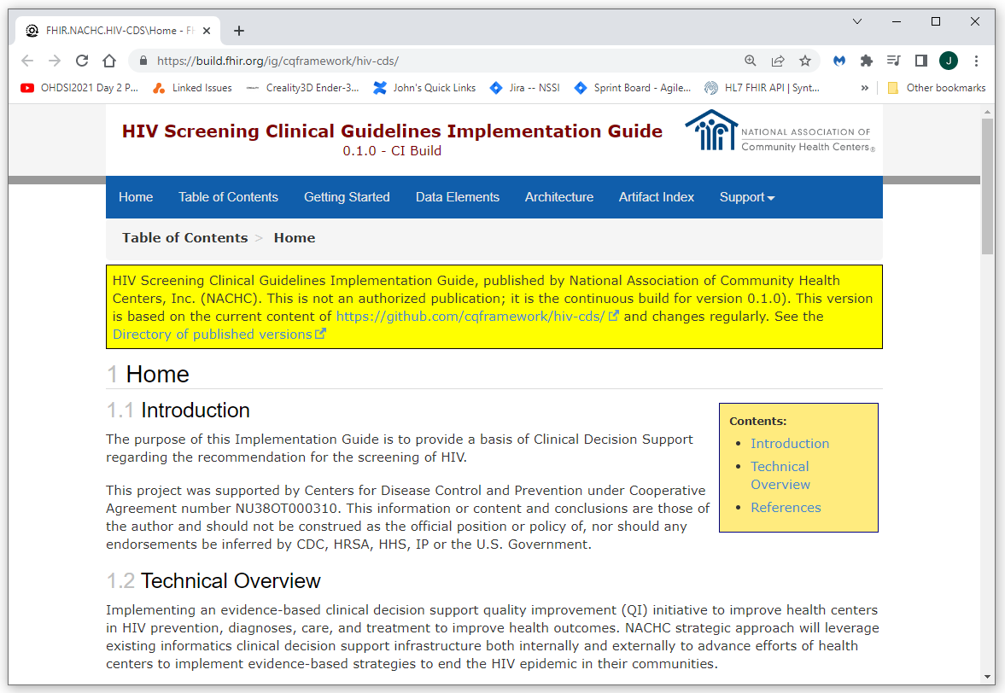
CDS Guidelines for HIV testing and the hiv-cds Implementation guide

Slide 9
Implementing the Applications:
SMART on FHIR

Slide 10
What is SMART on FHIR?
SMART on FHIR is a technology that allows applications to be launched directly from an EMR (or standalone applications to fully integrate with and EMR). The SMART on FHIR framework deals with all of the details of authentication and authorization. The SMART on FHIR framework enables the application to fully communicate with the EMR using FHIR. This includes reading as well as writing data to the EMR. This allows developers to focus on the business logic of their specific applications and enables a write once, run anywhere environment (with the caveat that all standards, including this one, have flexibility that will require customization in some cases). The stability and consistency provided by the SMART on FHIR standard has led to the creation of a wealth of publicly available applications that can be accessed through the App Gallery at https://apps.smarthealthit.org/ and the Application Stores and Application Orchards of major vendors such as Cerner and Epic. The stability and consistency provided by SMART on FHIR has also led to the development of tools and frameworks that can be used by developers to automate and otherwise streamline and improve their applications and efforts. These tools and frameworks include UX frameworks such as the LForms framework that automates the rendering, reading, and writing of FHIR Questionnaire and QuestionnaireResponse data and the Clinical Quality Language that manages and makes computable the complexities of clinical quality measures and clinical decision support.

Slide 11
What is SMART on FHIR: Key Points
What is SMART on FHIR?
SMART on FHIR is a technology that allows applications to be launched directly from an EMR (or standalone applications to fully integrate with and EMR).
SMART on FHIR provides a complete integration solution
The SMART on FHIR framework deals with all of the details of application integration so application developers can focus on the implementation of their specific business logic.
Write Once, Run Anywhere
SMART on FHIR enables a write once, run anywhere environment (with the caveat that all standards, including this one, have flexibility that will require customization in some cases).
A Wealth of Applications that Keeps Growing and Evolving
SMART on FHIR standard has led to the creation of a wealth of publicly available applications that can be accessed through the App Gallery at https://apps.smarthealthit.org/ and the Application Stores and Application Orchards of major vendors such as Cerner and Epic.
Integration With Other Third-party Frameworks
The stability and consistency provided by SMART on FHIR has also led to the development of tools and frameworks that can be used by developers to automate and otherwise streamline and improve their applications and efforts.

Slide 12
What is SMART on FHIR: Bottom Line
SMART on FHIR is an industry standard
Write a single application that can be incorporated into and SMART on FHIR enabled EMR, Patient Portal, or other application
Automate software development using computable resources such as CQL and FHIR Questionnaire resources

Slide 13
Clinical Decision Support

Slide 14
Clinical Decision Support
CDS Guidelines for HIV testing and the hiv-cds Implementation guide
The CDS guidelines for HIV testing have been compiled in to computable resources in the hiv-cds Implementation Guide
The hiv-cds Implementation guide uses Clinical Quality Language to define the CDS HIV testing guidelines
These CQL files can be read by software to automate the clinical decision process to determine if a patient should be given an HIV test based on the CDS guidelines

Slide 15
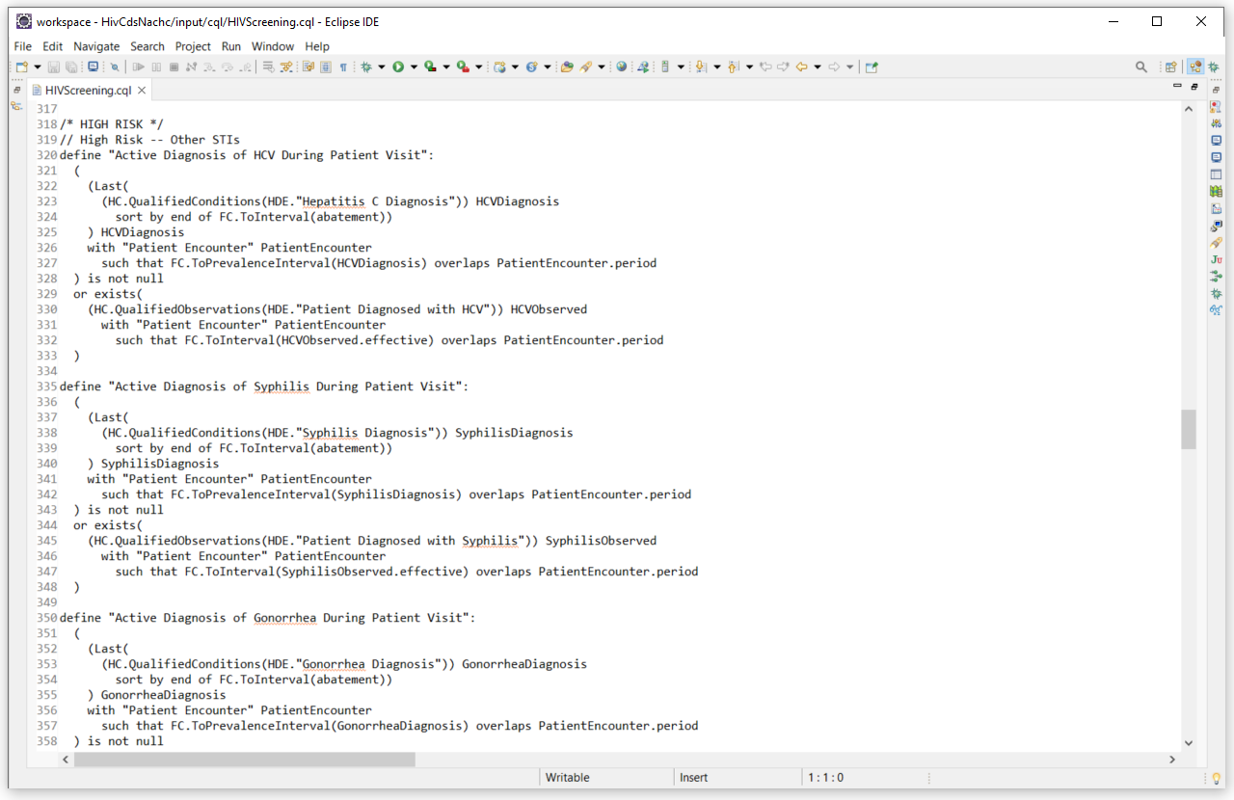
Clinical Decision Support
Implementation of CDS Guidelines as Clinical Quality Language (CQL)

Slide 16
Data Collection: Questionnaire FHIR Resources and Implementation Tools

Slide 17
Data Collection
FHIR Questionnaire Resources
The hiv-cds Implementation Guide contains FHIR Questionnaire resources that define what information needs to be collected for the CDS HIV testing guidelines
These resources can be used to automate the development of applications to collect these data
Display the form to end users
Capture the data from the form as a FHIR QuestionnaireResponse resource
The QuestionnaireResponse resource and be directly written to the EMR using SMART on FHIR

Slide 18
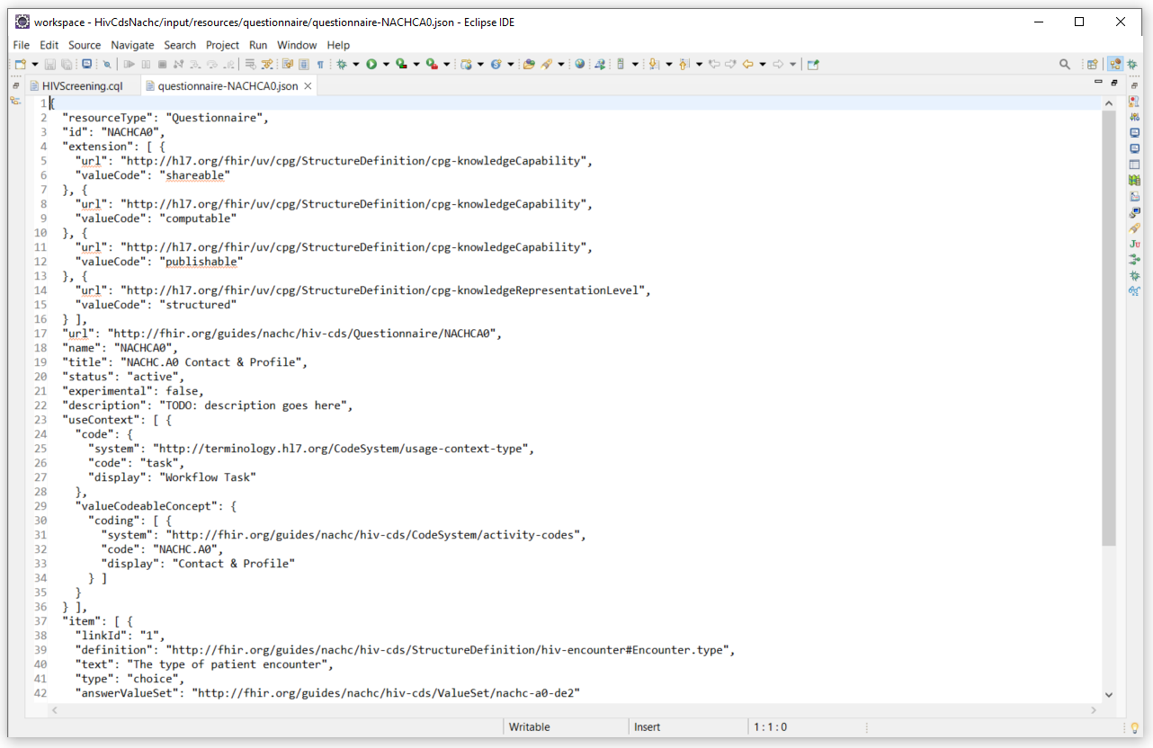
Data Collection
FHIR Questionnaire Resources

Slide 19
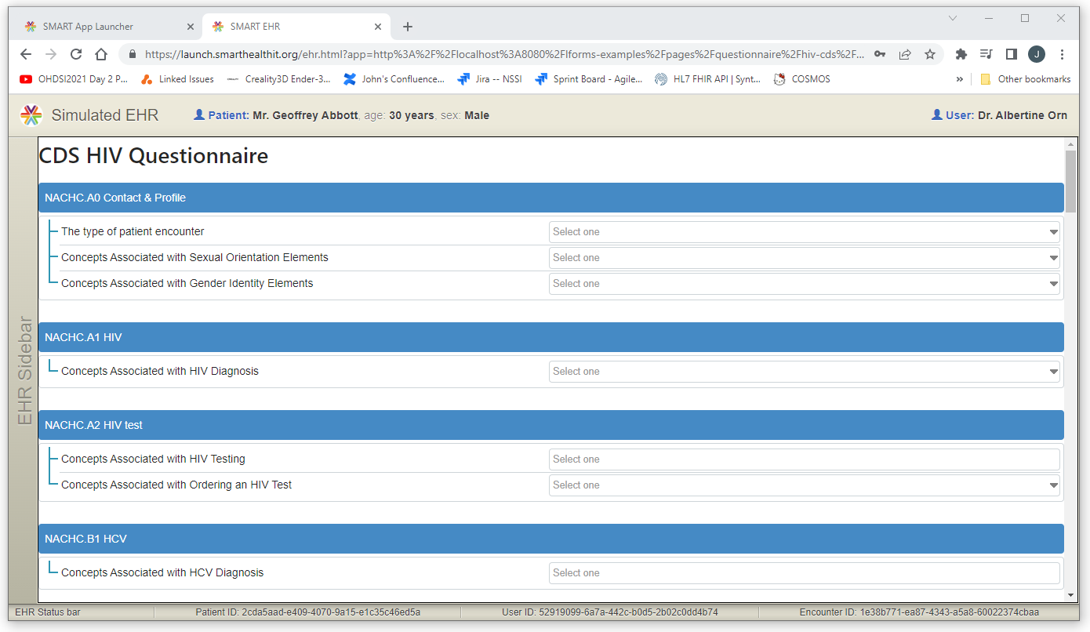
Data Collection
SMART on FHIR Survey Application Created using Questionnaire FHIR Resources

Slide 20
Summary
The NACHC hiv-cds Project and SMART on FHIR
Mission statement and project goals
Decrease transmission by targeted improvement of testing
Implementation strategy for the realization of the mission statement
Automation and re-use using SMART on FHIR
The hiv-cds Implementation Guide
Provides a blueprint and automation tools
SMART on FHIR implementation of the hiv-cds Implementation Guide
Re-use and automation through SMART on FHIR

Slide 21


